Slide 1
ASP.NET Core 5 Hands-On Training
Session 1: Introduction to ASP.NET Core

Slide 2
About Your Trainer
Mitchel Sellers
Microsoft MVP & ASPInsider
CEO @ IowaComputerGurus, Inc.
Contact Information
msellers@iowacomputergurus.com
Twitter: @MitchelSellers
Blog: http://www.mitchelsellers.com

Slide 3
Agenda
What is .NET Core? Why .NET Core?
Support Lifecycle?
Documentation
Breaking Changes & Upgrades
Project Types
.NET 5 & .NET 6
Identity
Entity Framework Core

Slide 4
What is .NET Core – Real World
Side-by-side deployment possibilities
No longer concerned about “is the server patched”
Better runtime experience
In VS, when not attached to the debugger can get realtime changes
Streamlined syntax requiring less work (TagHelpers)
<a asp-controller=“Home” asp-action=“Index”>Home</a>
Dependency Injection
Logging

Slide 5
Why .NET Core?
Initial Reasons
Performance & Features
Cleanliness
Now Reasons
You have to!

Slide 6
Practical Example of Benefits!
Existing ASP.NET MVC Project
Started at MVC 3 using WebMatrix User accounts
About 1,500 hours of development total
13 Controllers, 55 Views, 1 large data loader
Migrated to ASP.NET Core 1.1
Transitioned to full .NET Core
Transitioned to using Identity for authentication
Total cost about 140 man-hours
Result?
Performance benchmarks improved by 61% across the app
Specific data queries as much as 500 times faster
Migration to Core 2.0 was estimated at 8 hours
Migrated to ASP.NET Core 2.0
Total cost of about 12 man-hours
Performance improved again by about 15%
Migrated to ASP.NET Core 5.0
Total cost of <= 4 man-hours
Performance improved again by about 15%

Slide 7
Support Lifecycle
Looking back: .NET Framework
Framework patching done with OS
.NET 4.6 for example is good until 2029
Windows 11 introduces a much different pattern though
.NET Core: Introduces two tracks…
LTS (Long Term Support)
3 Years after initial date released (* 1.x is different)
Current
3 Months after subsequent LTS or Current release
.NET Core Current Versions
5.0.7 – Current – Estimated Expiration Jan, 2022
3.1.16 – LTS – Current End of Support Dec 3, 2022
2.1.28 – LTS – Current End of Support August 21, 2021
6.0 – Preview – Estimated Release November, Will be LTS

Slide 8
Very Frequent Releases!
1.0.0 – Initially Released June 2016
Major versions more than once per-year

Slide 9
Breaking Changes & Upgrades
.NET Core 1.0 –> 1.1
Minor inconvenience
.NET Core 1.x -> 2.0
10-20 hours, per project
.NET Core 2.0 -> 2.1
Minor inconvenience
.NET Core 2.0 -> 2.2
5-10 hours, per project
.NET Core 2.x -> 3.0
20-25 hours to do it RIGHT **
.NET Core 3.x -> 5.0
Minor inconvenience

Slide 10
Project Type Support
< .NET Core 3.0
Class Library
Console Application
Web Application
Can run “on .NET” or “on Core”
> .NET Core 3.0
All prior types
WinForms
WPF
.NET Core ONLY! – But can reference .NET Standard

Slide 11
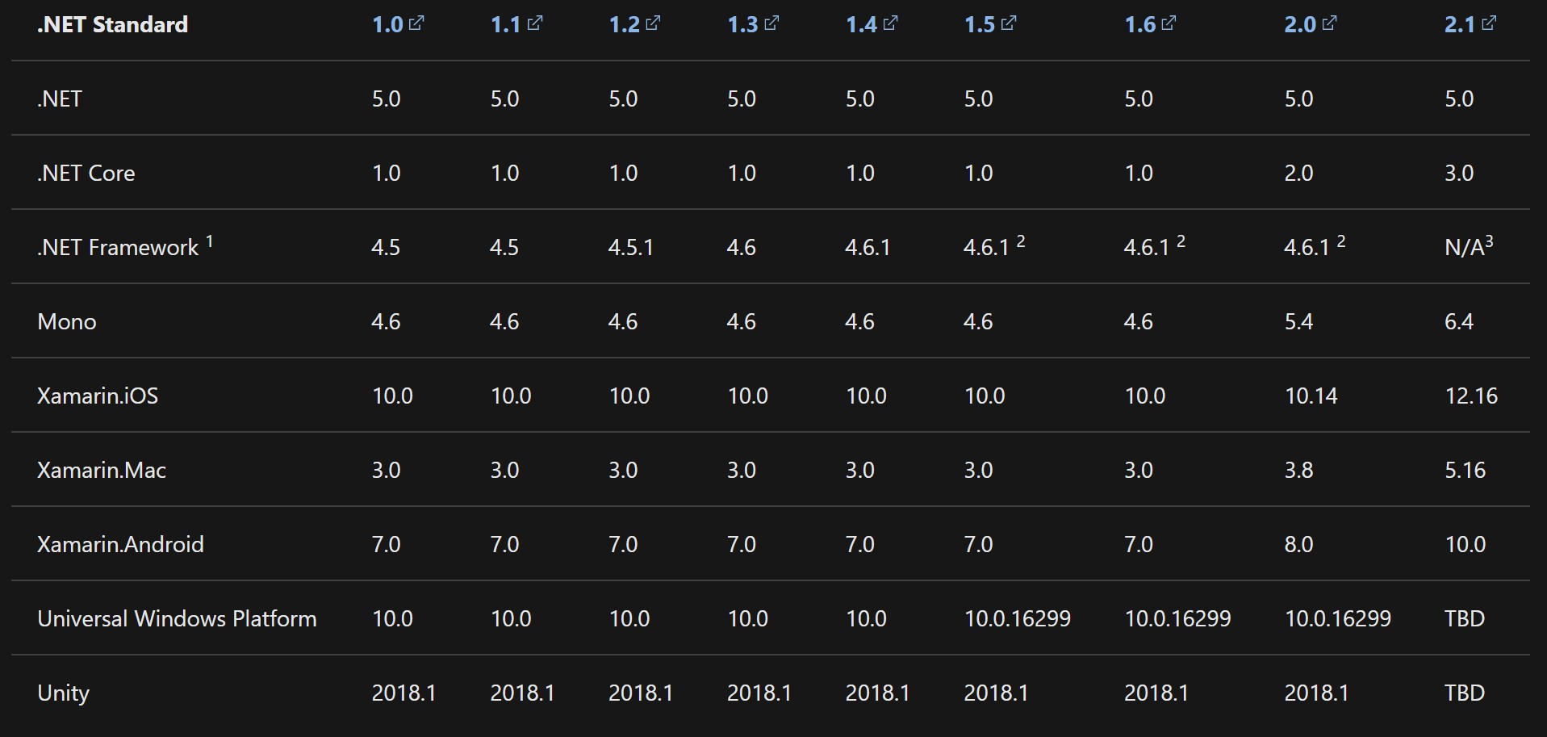
.NET Standard

Slide 12
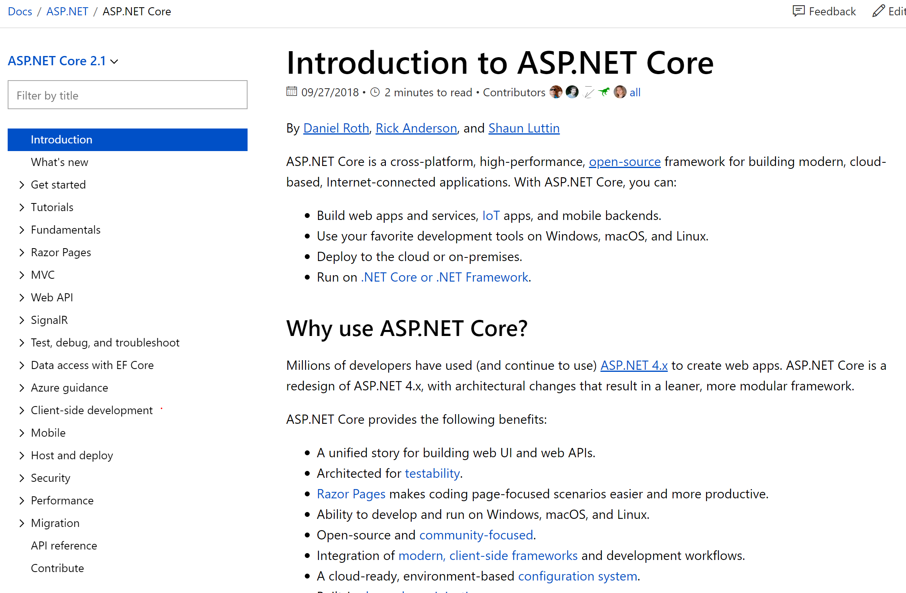
Documentation: It’s Awesome

Slide 13
But…..Awesome != Real-World
Most examples use a single project
Discussion on larger project scope is often overlooked
No standardized method to manage
Lacks consideration of things such as
Reusability
Separation of Concerns
Multiple Developers per Project
Componentization

Slide 14
Managing Expectations: Recipe Model
Recipes are great, but someone has to actually decide what is being built
Recipes are specific one-off examples, but not always the same.
For example many times you may start with X then do Y, but not always
Treat everything you see as simply a recipe, remembering that it is your responsibility to implement in your project

Slide 15
ASP.NET Core Identity
Amazing out of the box support for authentication/authorization in your application.
User Accounts
Azure Active Directory
Azure B2C Active Directory
OAuth

Slide 16
Entity Framework
Database ORM
Supports multiple database targets
Including SQL Server, MySQL etc
Also including an In-Memory Provider (Helpful for unit testing)
Compared to EF 6, much better
Still subject to “stupid programmer tricks”

Slide 17
Project Type Demos

Slide 18
Resources
Support Policy: https://dotnet.microsoft.com/platform/support/policy/dotnet-core

